Slide 1
Understanding and Preventing Phishing Attacks
Learn how to identify, avoid, and defend against phishing attacks and social engineering tactics.
Prepared by Sparsh Agarwal

Slide 2
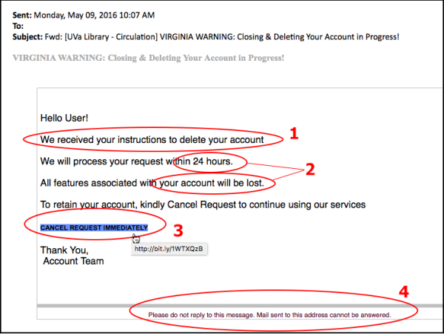
Recognizing Phishing Emails
- Suspicious sender addresses
- Generic greetings like 'Dear user'
- Urgent or threatening language
- Unexpected attachments or links
Prepared by Sparsh Agarwal

Slide 3
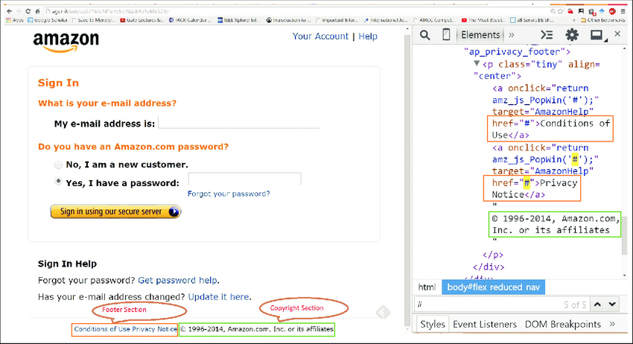
Identifying Fake Websites
- Look-alike URLs (e.g., g00gle.com)
- No HTTPS
- Typos or poor design
- Check domain registration
Prepared by Sparsh Agarwal

Slide 4
Social Engineering Tactics
- Impersonation of trusted entities
- Pretexting and baiting
- Scareware and urgency
- Emotional manipulation
Prepared by Sparsh Agarwal

Slide 5
Best Practices & Tips
- Never click unknown links
- Use two-factor authentication
- Regularly update passwords
- Verify requests via trusted sources
Prepared by Sparsh Agarwal

Slide 6
Real-World Examples
- 2020 Twitter bitcoin scam
- Fake bank emails
- Corporate credential phishing attacks
Prepared by Sparsh Agarwal

Slide 7
Interactive Quiz - Sample Questions
1. Which of these is a phishing indicator?
2. What should you do if you suspect a phishing email?
3. Which URL is likely fake?
Prepared by Sparsh Agarwal

Slide 8
Final Tips & Resources
- Visit trusted cybersecurity sites
- Contact internal IT for help
- Use tools like VirusTotal, URLVoid
Prepared by Sparsh Agarwal

